Slide 1
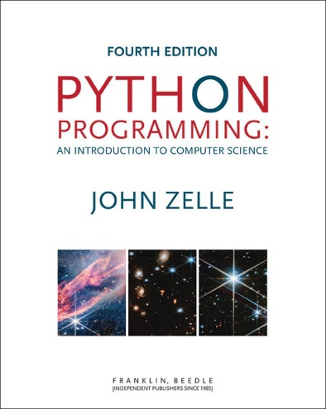
Python Programming: An Introduction to Computer Science
Chapter 1
Computers and Programs

Slide 2
Objectives
To understand the respective roles of hardware and software in computing systems.
To learn what computer scientists study and the techniques that they use.
To understand the basic design of a modern computer and the role played by the operating system.

Slide 3
Objectives (cont.)
To understand the form and function of computer programming languages.
To begin using the Python programming language.
To learn about chaotic models and their implications for computing.

Slide 4
The Universal Machine
A modern computer can be defined as “a machine that stores and manipulates information under the control of a changeable program.”
Two key elements:
Computers are devices for manipulating information.
Computers operate under the control of a changeable program.

Slide 5
The Universal Machine
What is a computer program?
A detailed, step-by-step set of instructions telling a computer what to do.
If we change the program, the computer performs a different set of actions or a different task.
The machine stays the same, but the program changes!

Slide 6
The Universal Machine
Programs are executed, or carried out.
All computers have the same power, with suitable programming, i.e. each computer can do the things any other computer can do.

Slide 7
Program Power
Software (programs) rules the hardware (the physical machine).
The process of creating this software is called programming or coding.
Why learn to program?
Fundamental part of computer science
Having an understanding of programming helps you have an understanding of the strengths and limitations of computers.

Slide 8
Program Power
Helps you become a more intelligent user of computers
It can be fun!
Form of expression
Helps the development of problem solving skills, especially in analyzing complex systems by reducing them to interactions between simpler systems.
Programmers are in great demand!

Slide 9
What is Computer Science?
It is not the study of computers! “Computers are to computer science what telescopes are to astronomy.” – E. Dijkstra
The question becomes, “What processes can be described?”
This question is really, “What can be computed?”

Slide 10
What is Computer Science?
Design
One way to show a particular problem can be solved is to actually design a solution.
This is done by developing an algorithm, a step-by-step process for achieving the desired result.
One problem – it can only answer in the positive. You can’t prove a negative!

Slide 11
What is Computer Science?
Analysis
Analysis is the process of examining algorithms and problems mathematically.
Some seemingly simple problems are not solvable by any algorithm. These problems are said to be unsolvable.
Problems can be intractable if they would take too long or take too much memory to be of practical value.

Slide 12
What is Computer Science?
Experimentation
Some problems are too complex for analysis.
Implement a system and then study its behaviour.

Slide 13
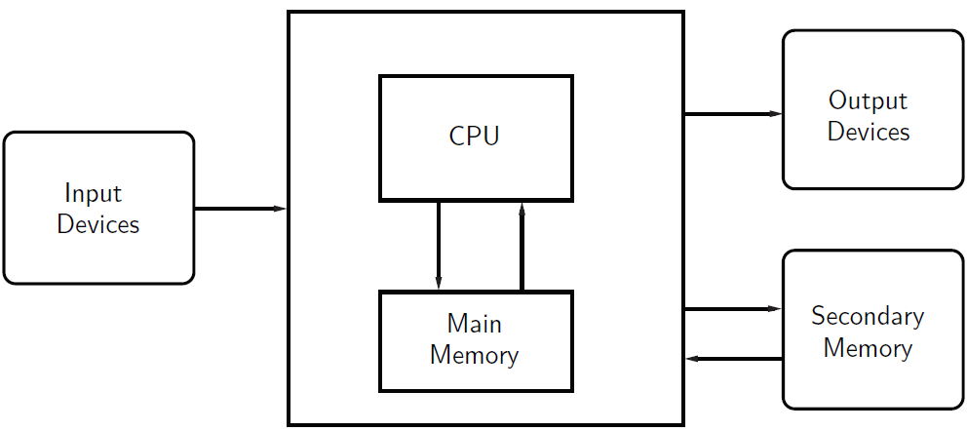
Hardware Basics

Slide 14
Hardware Basics
The central processing unit (CPU) is the “brain” of a computer.
The CPU carries out all the basic operations on the data.
Examples: simple arithmetic operations, testing to see if two numbers are equal.

Slide 15
Hardware Basics
Memory stores programs and data.
CPU can only directly access information stored in main memory (RAM or Random Access Memory).
Main memory is fast, but volatile, i.e. when the power is interrupted, the contents of memory are lost.
Secondary memory provides more permanent storage: magnetic (hard drive), flash (SSD, USB memory), optical (CD, DVD)

Slide 16
Hardware Basics
Input devices
Information is passed to the computer through keyboards, mice, etc.
Output devices
Processed information is presented to the user through the monitor, printer, etc.
Some devices act as both input and output devices, e.g. network controller.

Slide 17
Hardware Basics
Fetch-Execute Cycle
First instruction retrieved from memory
Decode the instruction to see what it represents
Appropriate action carried out.
Next instruction fetched, decoded, and executed.
Lather, rinse, repeat!

Slide 18
Operating Systems
Who’s in charge of what instructions are executing at a given moment? The operating system.
An OS is a suite of software that controls the various hardware resources of a computer, binding the components together so they act as a unified whole.
Examples: Windows, MacOS, Linux, ChromeOS, iOS, Android.

Slide 19
Operating Systems
The OS manages all of the computer’s resources.
The bootstrap loader is a small program initially loaded into RAM when the computer is first turned on or restarted that loads the OS kernel.
The kernel is the part of the OS that is always running.

Slide 20
Operating Systems
The kernel can give up the CPU to allow another program to run, but it will interrupt at regular intervals to retake control.
Then the kernel can hand off the CPU to another program.
By doing this switch quickly among multiple loaded programs, this gives the appearance of running the programs simultaneously.

Slide 21
Operating Systems
Important points
Files are used to store data.
Files can store audio, images, text, applications (programs), etc.
The OS has to keep track of what the contents of the file are somehow. A general way to do this is to indicate the type of data with the file extensions, i.e. mysong.mp3.
One problem – some operating systems make it hard to see the extension. What if you also have mysong.wav?
Tip 1: Do some research to see how to turn on the ability to see the extension in the folders where you’ll store your code.

Slide 22
Operating Systems
The hierarchical structure of directories/folders on your computer is essential to keeping tables on all your information.
In addition to your own files, there are a number of operating system-specific files on your computer.
Keep your files in your space, let the system keep its files in its space.
You will typically have a home or user folder called “Documents”.

Slide 23
Operating Systems
Tip 2 – create a directory/folder to store ALL your work for this class. Create it in your home directory, the Desktop, or someplace easy to find.

Slide 24
Programming Languages
Natural language has ambiguity and imprecision problems when used to describe complex algorithms.
Programs expressed in an unambiguous, precise way using programming languages.
Every structure in programming language has a precise form, called its syntax
Every structure in programming language has a precise meaning, called its semantics.

Slide 25
Programming Languages
Programming language like a code for writing the instructions the computer will follow.
Programmers will often refer to their program as computer code.
Process of writing an algorithm in a programming language often called coding.

Slide 26
Programming Languages
High-level computer languages
Designed to be used and understood by humans
Low-level language
Computer hardware can only understand a very low level language known as machine language

Slide 27
Programming Languages
Add two numbers:
Load the number from memory location 2001 into the CPU
Load the number from memory location 2002 into the CPU
Add the two numbers in the CPU
Store the result into location 2003
In reality, these low-level instructions are represented in binary (1’s and 0’s)

Slide 28
Programming Languages
High-level language c = a + b
This needs to be translated into machine language that the computer can execute.
Compilers convert programs written in a high-level language into the machine language of some computer.

Slide 29
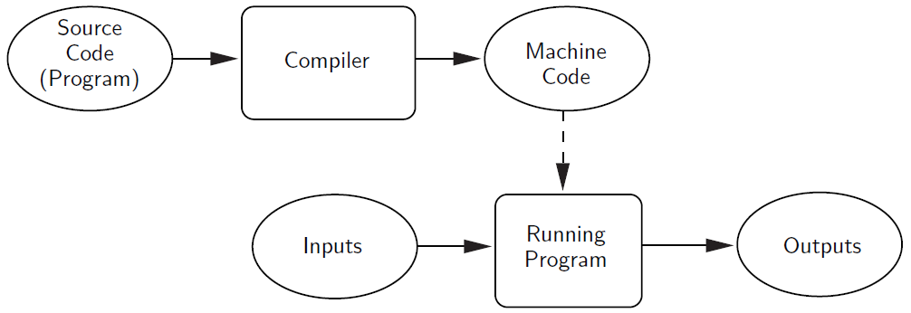
Programming Languages

Slide 30
Programming Languages
Interpreters simulate a computer that understands a high-level language.
The source program is not translated into machine language all at once.
An interpreter analyzes and executes the source code instruction by instruction.

Slide 31
Programming Languages

Slide 32
Programming Languages
Compiling vs. Interpreting
Once program is compiled, it can be executed over and over without the source code or compiler. If it is interpreted, the source code and interpreter are needed each time the program runs
Compiled programs generally run faster since the translation of the source code happens only once.

Slide 33
Programming Languages
Interpreted languages are part of a more flexible programming environment since they can be developed and run interactively
Interpreted programs are more portable, meaning the executable code produced from a compiler for a Pentium won’t run on a Mac, without recompiling. If a suitable interpreter already exists, the interpreted code can be run with no modifications.

Slide 34
The Magic of Python
When you start Python, you will see something like:
Python 3.11.4 (tags/v3.11.4:d2340ef, Jun 7 2023, 05:45:37) [MSC v.1934 64 bit (AMD64)] on win32
Type "help", "copyright", "credits" or "license()" for more information.
>>>

Slide 35
The Magic of Python
The “>>>” is a Python prompt indicating that Python is ready for us to give it a command. These commands are called statements.
>>> print("Hello, world") Hello, world >>> print(2+3) 5 >>> print("2+3=", 2+3) 2+3= 5 >>>

Slide 36
The Magic of Python
Usually we want to execute several statements together that solve a common problem. One way to do this is to use a function.
>>> def hello(): print("Hello") print("Computers are Fun") >>>

Slide 37
The Magic of Python
>>> def hello(): print("Hello") print("Computers are Fun") >>>
The first line tells Python we are defining a new function called hello.
The following lines are indented to show that they are part of the hello function.
The blank line (hit enter twice) lets Python know the definition is finished.

Slide 38
The Magic of Python
>>> def hello(): print("Hello") print("Computers are Fun") >>>
Notice that nothing has happened yet! We’ve defined the function, but we haven’t told Python to perform the function!
A function is invoked (or called) by typing its name.
>>> hello() Hello Computers are Fun >>>

Slide 39
The Magic of Python
What’s the deal with the ()’s?
Commands can have changeable parts called parameters (or arguments) that are placed between the ()’s.
>>> def greet(person): print("Hello",person) print ("How are you?") >>>

Slide 40
The Magic of Python
>>> greet("Terry") Hello Terry How are you? >>> greet("Paula") Hello Paula How are you? >>>
When we use parameters, we can customize the output of our function.

Slide 41
The Magic of Python
When we exit the Python prompt, the functions we’ve defined cease to exist!
Programs are usually composed of functions, modules, or scripts that are saved on disk so that they can be used again and again.
A module file is a text file created in text editing software (saved as “plain text”) that contains function definitions.
An integrated development environment (IDE) is designed to help programmers write programs and usually includes automatic indenting, highlighting, etc.

Slide 42
The Magic of Python
# File: chaos.py
# A simple program illustrating chaotic behavior
def main():
print("This program illustrates a chaotic function")
x = float(input("Enter a number between 0 and 1: "))
for i in range(10):
x = 3.9 * x * (1 - x)
print(x)
main()
We’ll use filename.py when we save our work to indicate it’s a Python program.
In this code we’re defining a new function called main.
The main() at the end tells Python to run the code.

Slide 43
The Magic of Python
>>>
This program illustrates a chaotic function
Enter a number between 0 and 1: .5
0.975
0.0950625
0.335499922266
0.869464925259
0.442633109113
0.962165255337
0.141972779362
0.4750843862
0.972578927537
0.104009713267
>>>

Slide 44
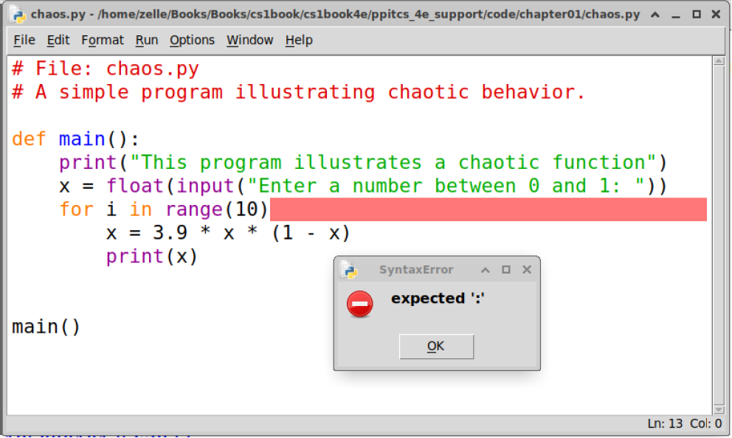
The Magic of Python
What happens if you leave out the “:”?

Slide 45
The Magic of Python
Traceback messages
This tells us the error is somewhere on line six…
This program illustrates a chaotic function
Traceback (most recent call last):
File "C:/Users/terry/Desktop/chaos.py", line 10, in <module>
main()
File "C:/Users/terry/Desktop/chaos.py", line 6, in main
x = floar(input("Enter a number between 0 and 1: "))
NameError: name 'floar' is not defined. Did you mean: 'float’?

Slide 46
Inside a Python Program
# File: chaos.py
# A simple program illustrating chaotic behavior
Lines that start with # are called comments
Intended for human readers and ignored by Python
Python skips text from # to end of line

Slide 47
Inside a Python Program
def main():
Beginning of the definition of a function called main
Since our program has only this one module, it could have been written without the main function.
The use of main is customary, however.

Slide 48
Inside a Python Program
print("This program illustrates a chaotic function")
This line causes Python to print a message introducing the program.

Slide 49
Inside a Python Program
x = eval(input("Enter a number between 0 and 1: "))
x is an example of a variable
A variable is used to assign a name to a value so that we can refer to it later.
The quoted information is displayed, and the number typed in response is stored in x.

Slide 50
Inside a Python Program
for i in range(10):
For is a loop construct
A loop tells Python to repeat the same thing over and over.
In this example, the following code will be repeated 10 times.

Slide 51
Inside a Python Program
x = 3.9 * x * (1 - x)
print(x)
These lines are the body of the loop.
The body of the loop is what gets repeated each time through the loop.
The body of the loop is identified through indentation.
The effect of the loop is the same as repeating these two lines 10 times!

Slide 52
Inside a Python Program
x = 3.9 * x * (1 - x)
print(x)
x = 3.9 * x * (1 - x)
print(x)
x = 3.9 * x * (1 - x)
print(x)
x = 3.9 * x * (1 - x)
print(x)
x = 3.9 * x * (1 - x)
print(x)
x = 3.9 * x * (1 - x)
print(x)
x = 3.9 * x * (1 - x)
print(x)
x = 3.9 * x * (1 - x)
print(x)
x = 3.9 * x * (1 - x)
print(x)
x = 3.9 * x * (1 - x)
print(x)
for i in range(10):
x = 3.9 * x * (1 - x)
print(x)
These are equivalent!

Slide 53
Inside a Python Program
x = 3.9 * x * (1 - x)
This is called an assignment statement
The part on the right-hand side (RHS) of the "=" is a mathematical expression.
* is used to indicate multiplication
Once the value on the RHS is computed, it is stored back into (assigned) into x

Slide 54
Inside a Python Program
main()
This last line tells Python to execute the code in the function main

Slide 55
Chaos and Computers
The chaos.py program:
def main():
print("This program illustrates a chaotic function")
x = eval(input("Enter a number between 0 and 1: "))
for i in range(10):
x = 3.9 * x * (1 - x)
print(x)
main()
For any given input, returns 10 seemingly random numbers between 0 and 1
It appears that the value of x is chaotic

Slide 56
Chaos and Computers
The function computed by program has the general form where k is 3.9
This type of function is known as a logistic function.
Models certain kinds of unstable electronic circuits and population variation under limiting conditions.
Very small differences in initial value can have large differences in the output.

Slide 57
Chaos and Computers
Input: 0.25
0.73125
0.76644140625
0.698135010439
0.82189581879
0.570894019197
0.955398748364
0.166186721954
0.540417912062
0.9686289303
0.118509010176
Input: 0.26
0.75036
0.73054749456
0.767706625733
0.6954993339
0.825942040734
0.560670965721
0.960644232282
0.147446875935
0.490254549376
0.974629602149

